Slide 1
Event-driven Data Pipeline for E-commerce Project
Presented by-Vishnu and Vaishnavi

Slide 2
Table of contents
01
02
03
Problem statement
Project overview
Design solutions for building pipelines
06
04
05
Schema Diagram
Business outcomes and impacts
Visualizations

Slide 3

Problem Statement
E-commerce businesses generate massive volumes of user interaction and transactional data every day. These events are often unstructured, arrive in real-time, and can originate from multiple sources such as website clicks, mobile apps, and purchase transactions. Traditional batch processing methods fail to provide immediate insights into customer behavior, product performance, and conversion trends.

Slide 4
The problem:
Lack of real-time insights into customer behavior and transactions.
Difficulty in tracking the complete customer journey across multiple touchpoints.
Challenges in building actionable analytics due to scattered or unprocessed event data.
Solution: Develop an event-driven data pipeline that ingests, processes, and analyzes both real-time and historical e-commerce events, creating a centralized analytics platform in BigQuery with data marts for specific analytical use cases.

Slide 5
Motivation
Real-time customer insights allow businesses to respond quickly with personalized offers, recommendations, or interventions.
Building an automated pipeline reduces manual effort, ensures data consistency, and improves decision-making.
Understanding the customer journey can increase conversions and revenue by optimizing the shopping funnel.
Leveraging BigQuery ensures scalability for large e-commerce datasets while enabling fast analytics.

Slide 6
Project Overview
Design and implement a data pipeline to capture, process, and analyze e-commerce events.
Integrate historical datasets (Brazilian E-Commerce Public Dataset) with real-time synthetic events (using Python Faker library).
Perform data transformation, sessionization, and enrichment for actionable insights.
Organize data into dimensional models and data marts for analytics efficiency.
Store and analyze data in BigQuery for fast, scalable querying.
Provide interactive Streamlit dashboards to visualize customer behavior, shopping funnels, and product performance.

Slide 7
Design Solutions For Building Pipelines
High level Design
Low level design

Slide 8
High Level Design

Slide 9
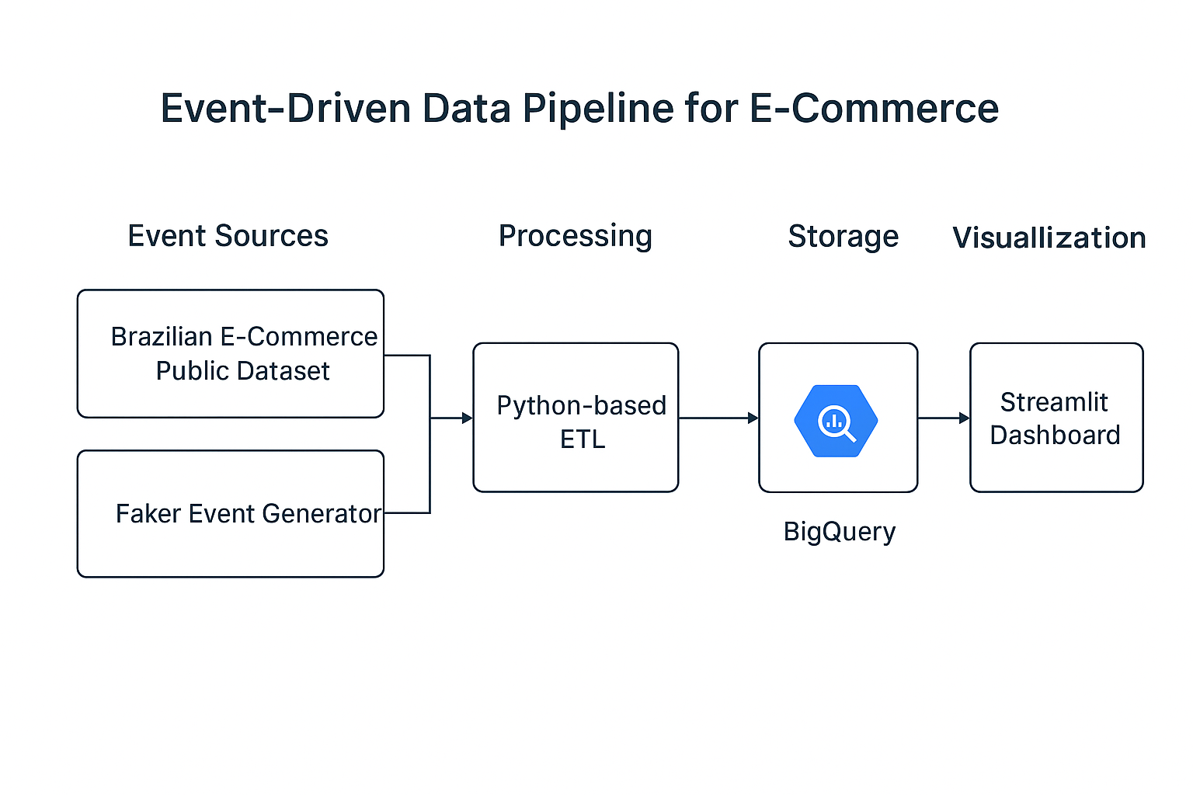

Slide 10
Low Level Design

Slide 11
Low Level design
Data Sources:
Historical: Brazilian E-Commerce Dataset (orders, customers, products)
Real-time: Synthetic events using Python Faker library
Data Ingestion:
Python ETL scripts for batch & real-time event loading
Data Transformation / Processing:
Data cleaning: Remove duplicates, handle missing values

Slide 12
BigQuery Schema:
Fact table: fact_order_items
Dimension tables: dim_date,dim_customer,review rev,dim_order,dim_payment,dim_product
Data Marts:
Customer Journey Mart: Sessions, page views, conversions
Shopping Funnel Mart: Visit → Add to Cart → Purchase → Repeat
Product Performance Mart: Sales, revenue, top products
Dashboard Layer:
Streamlit dashboards for KPIs, funnel visualization, and trend analysis

Slide 13
Schema Diagram

Slide 14
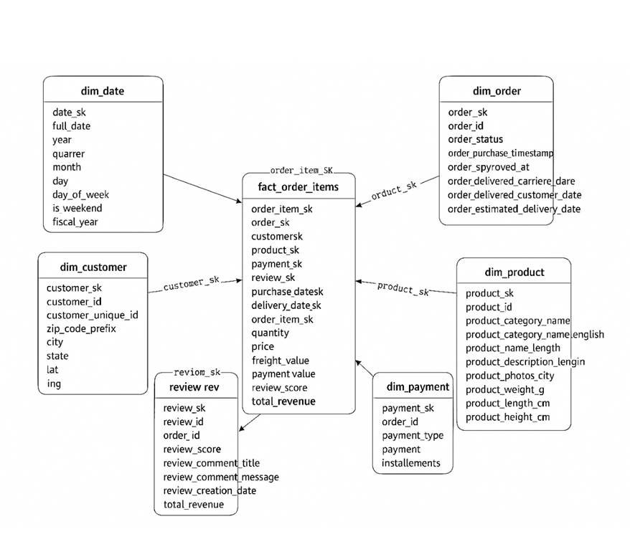

Slide 15
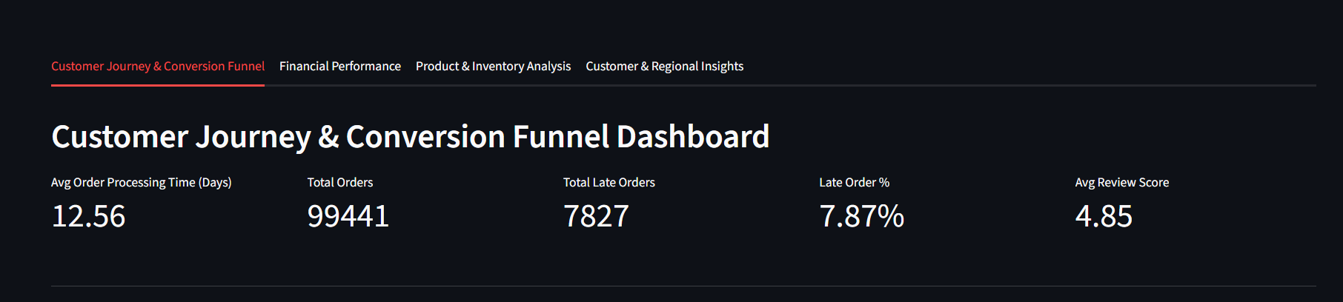
Visualizations
Customer journey and conversion funnel
The above image describes about key metrics of customer journey through e commerce website

Slide 16
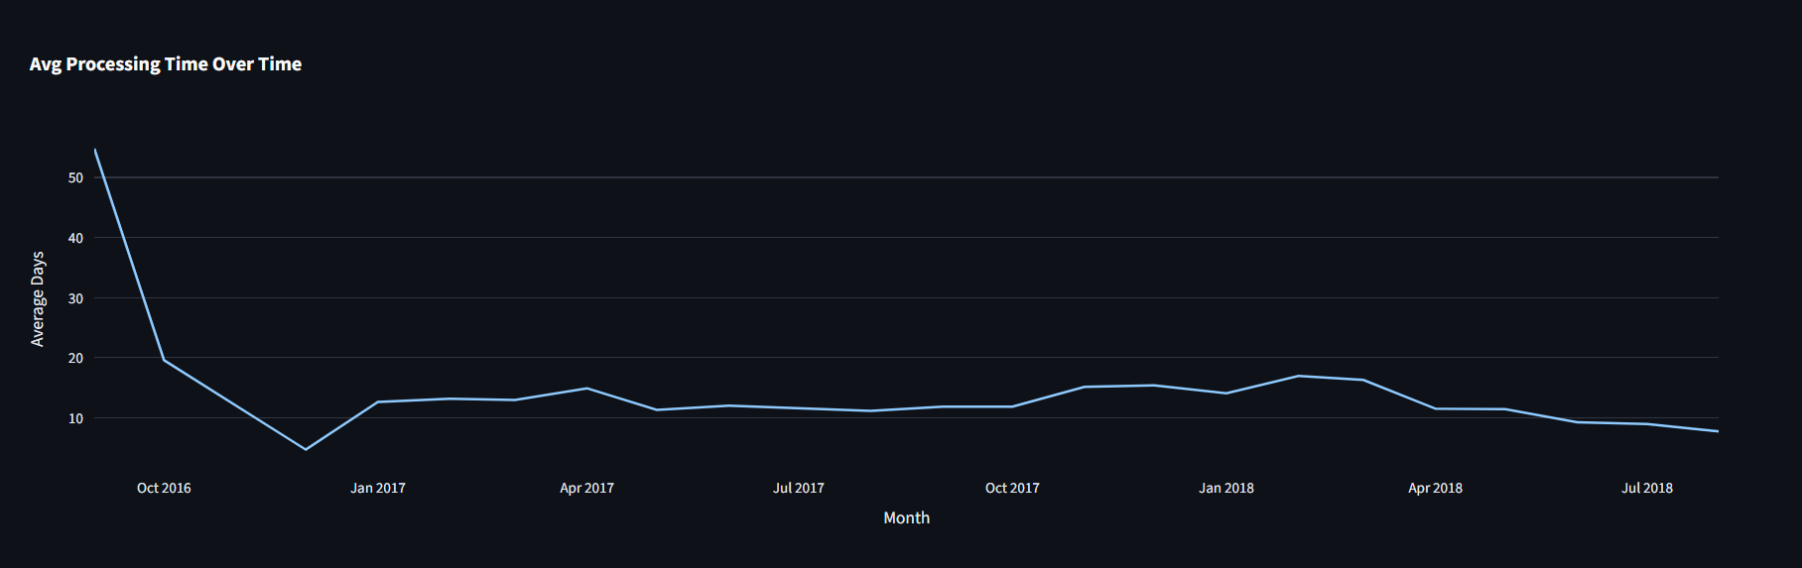
The above image describes about Average order processing time by the customers

Slide 17
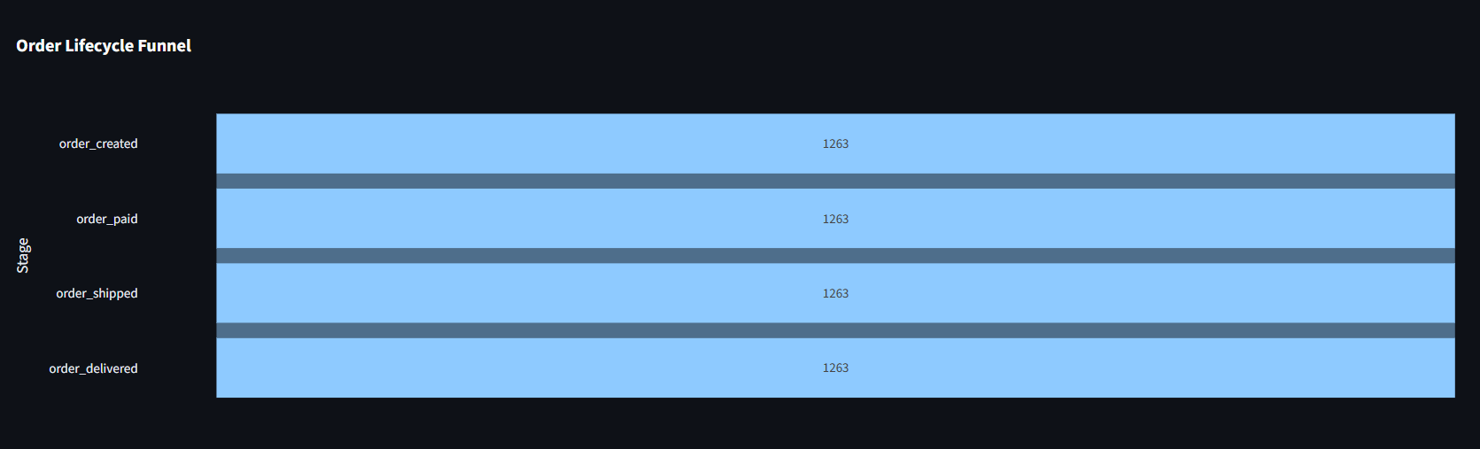
The above Image describes about Average Lifecycle funnel by the Customers Spent on each event

Slide 18
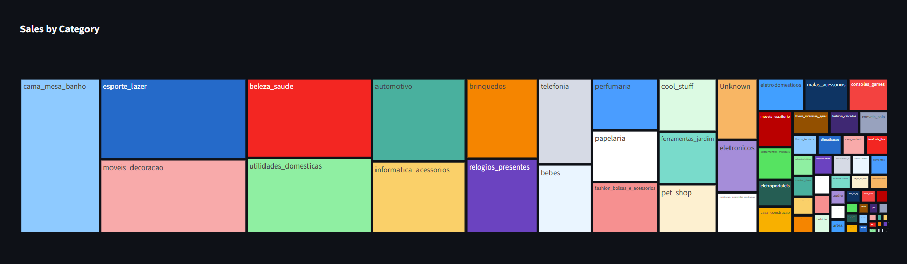
Financial Performance
Financial performance of the each product category in the Brazilian Data set(Historical Data source)

Slide 19
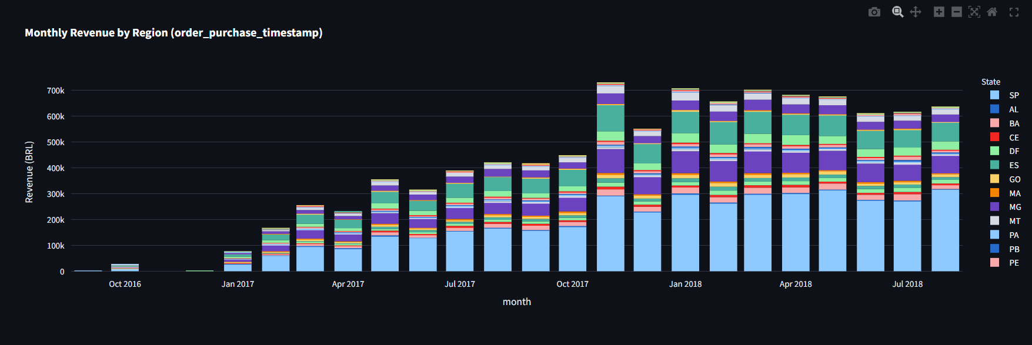
The above image Describes about Monthly Revenue by each Product Category related to Brazilian Dataset

Slide 20
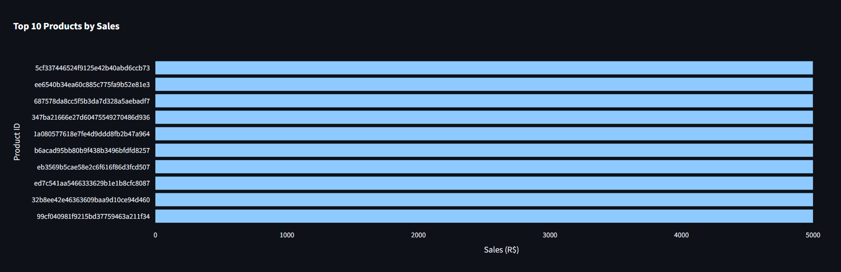
Product and Inventory Analysis
The above image describes about the Top 10 product Ids By Sales

Slide 21
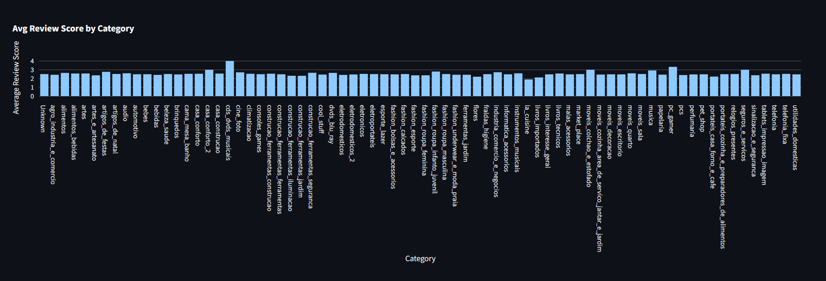
The above Image describes about Average Review Score of Customers By Category

Slide 22
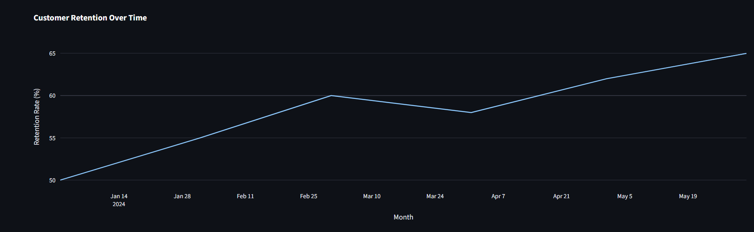
Customer and Regional Insights
The above Image describes “How the customers retained to order over a period of time “!

Slide 23
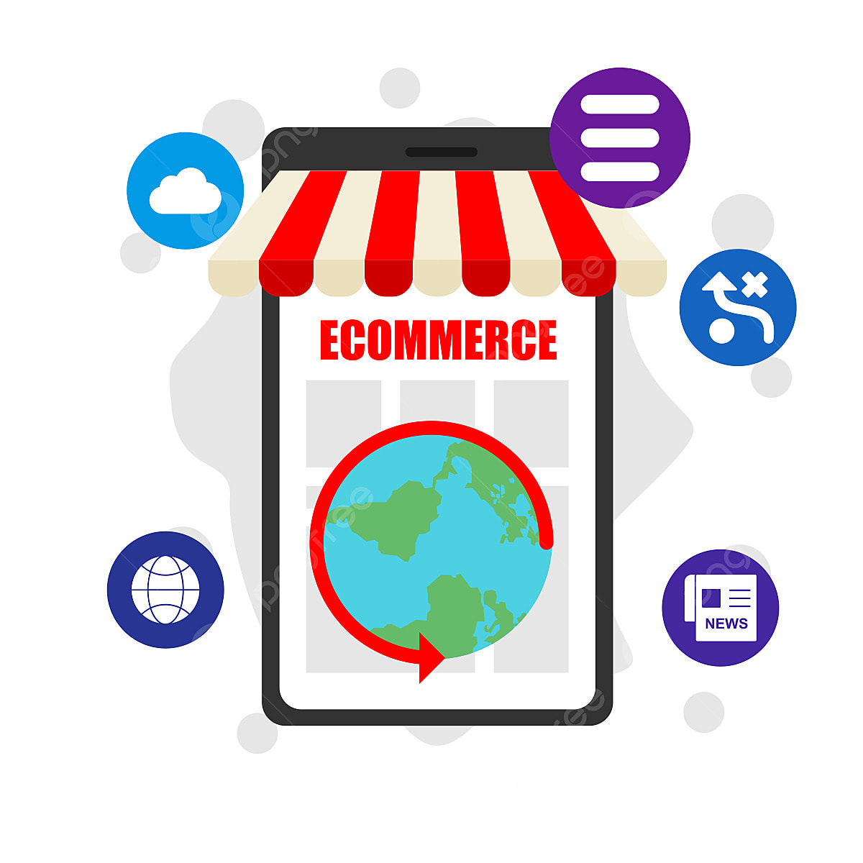
Business Outcomes and Impacts
Real-time Customer Insights: Track behavior, interactions, and purchases instantly.
Boost Sales & Conversions: Identify funnel drop-offs and optimize checkout flow.
Product & Category Performance: Spot top-selling items and underperforming products.
Operational Efficiency: Monitor orders, shipping, and payments to reduce delays.
Data-Driven Decisions: Dashboards enable marketing, sales, and inventory teams to act quickly.

Slide 24
Thank you

